Slide 1
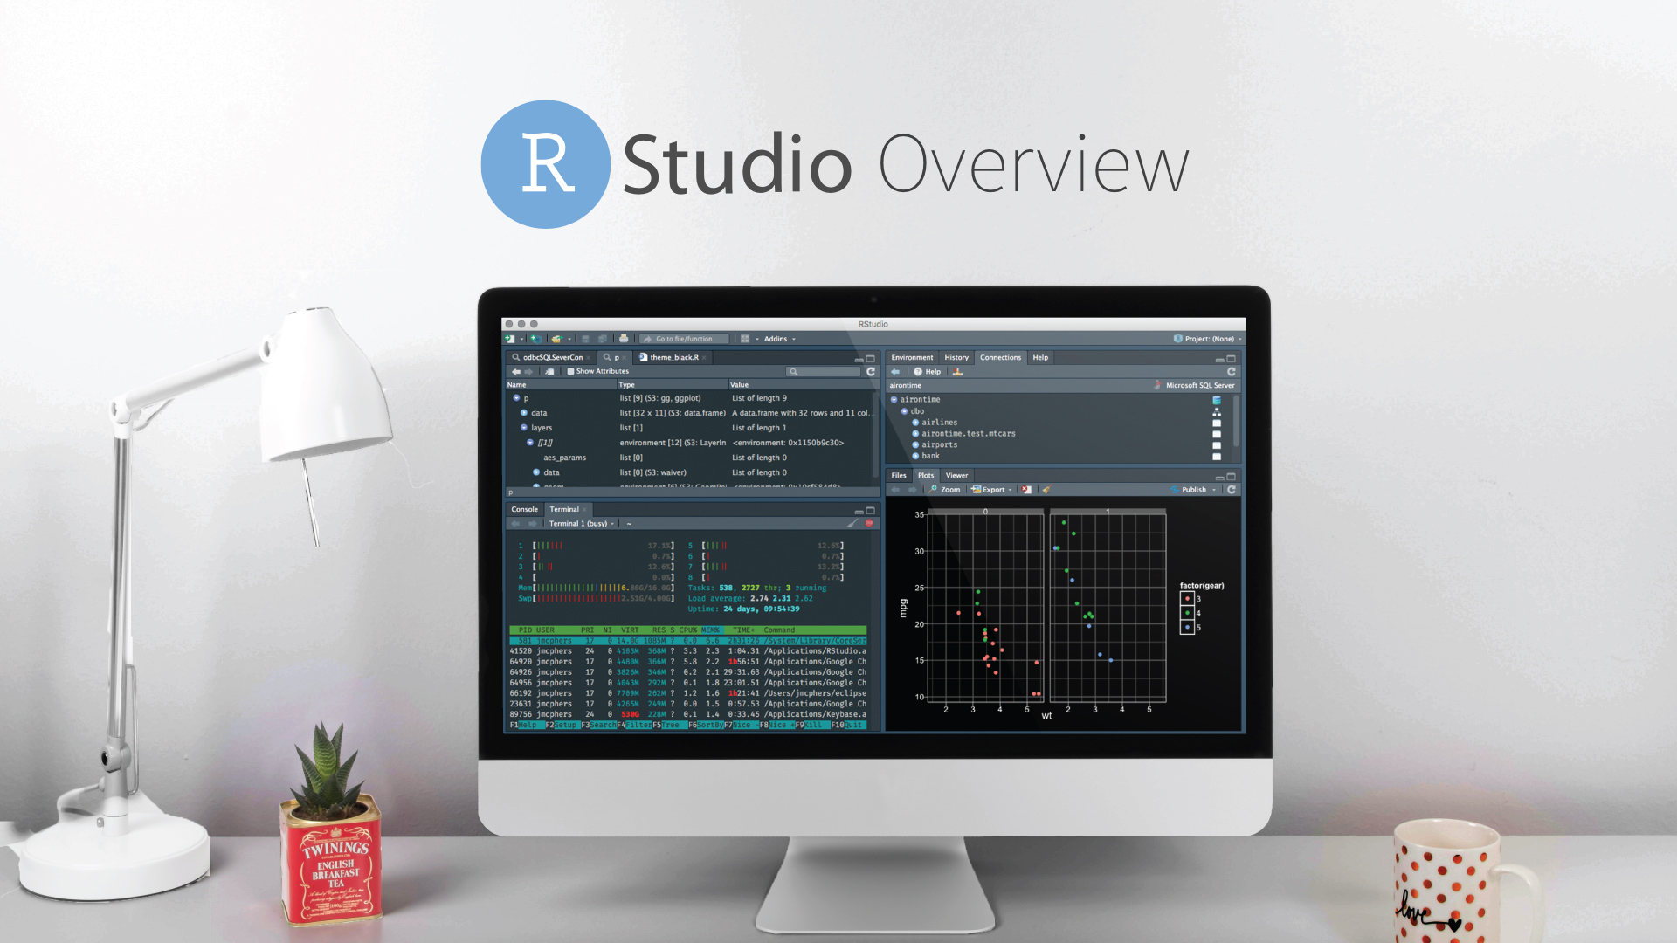
December 2019
Notes:
RStudio tour: https://rstudio.com/products/rstudio/

Slide 2
Scheduled RStudio Webinars
Topic | Description | Date
Shiny application development | Write a shiny app from scratch. | 7/17/19
Intro to R Markdown | Parameterized Reports, and Publishing to Connect | 8/8/19
Host Tensorflow models | Publish your tensorflow python models on Rstudio Connect for online or batch scoring. | 11/7/19
RStudio Server Pro | An overview of RStudio Server Pro | 12/5/19
Convert R code into REST API | How to publish your R code to a web service that can be used by others. | 1/20/20

Slide 3
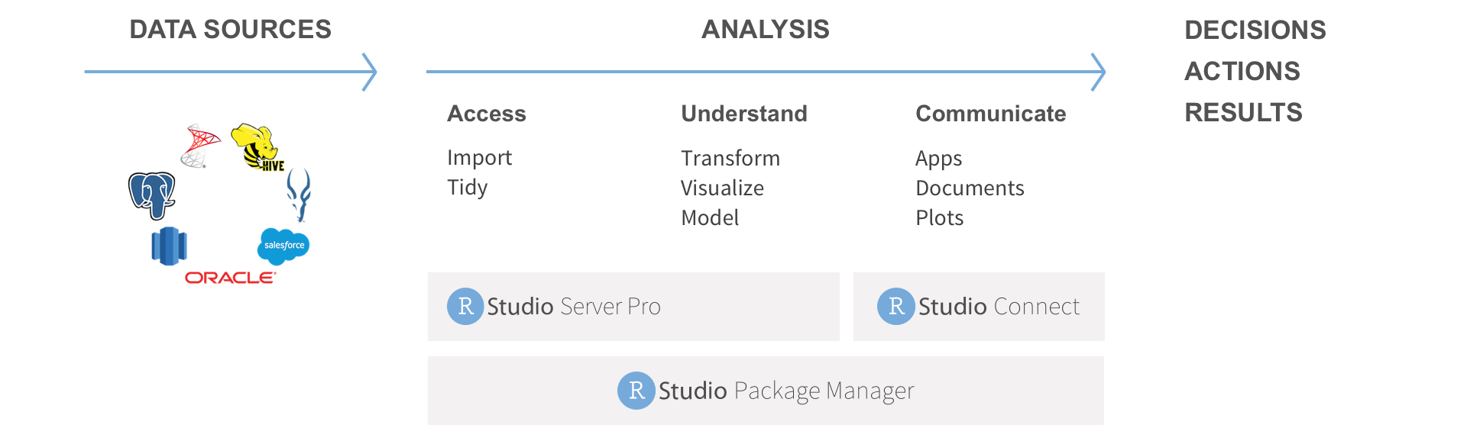
Where RStudio fits in
RStudio’s Pro products help enterprises support R developers and their consumers.

Slide 4
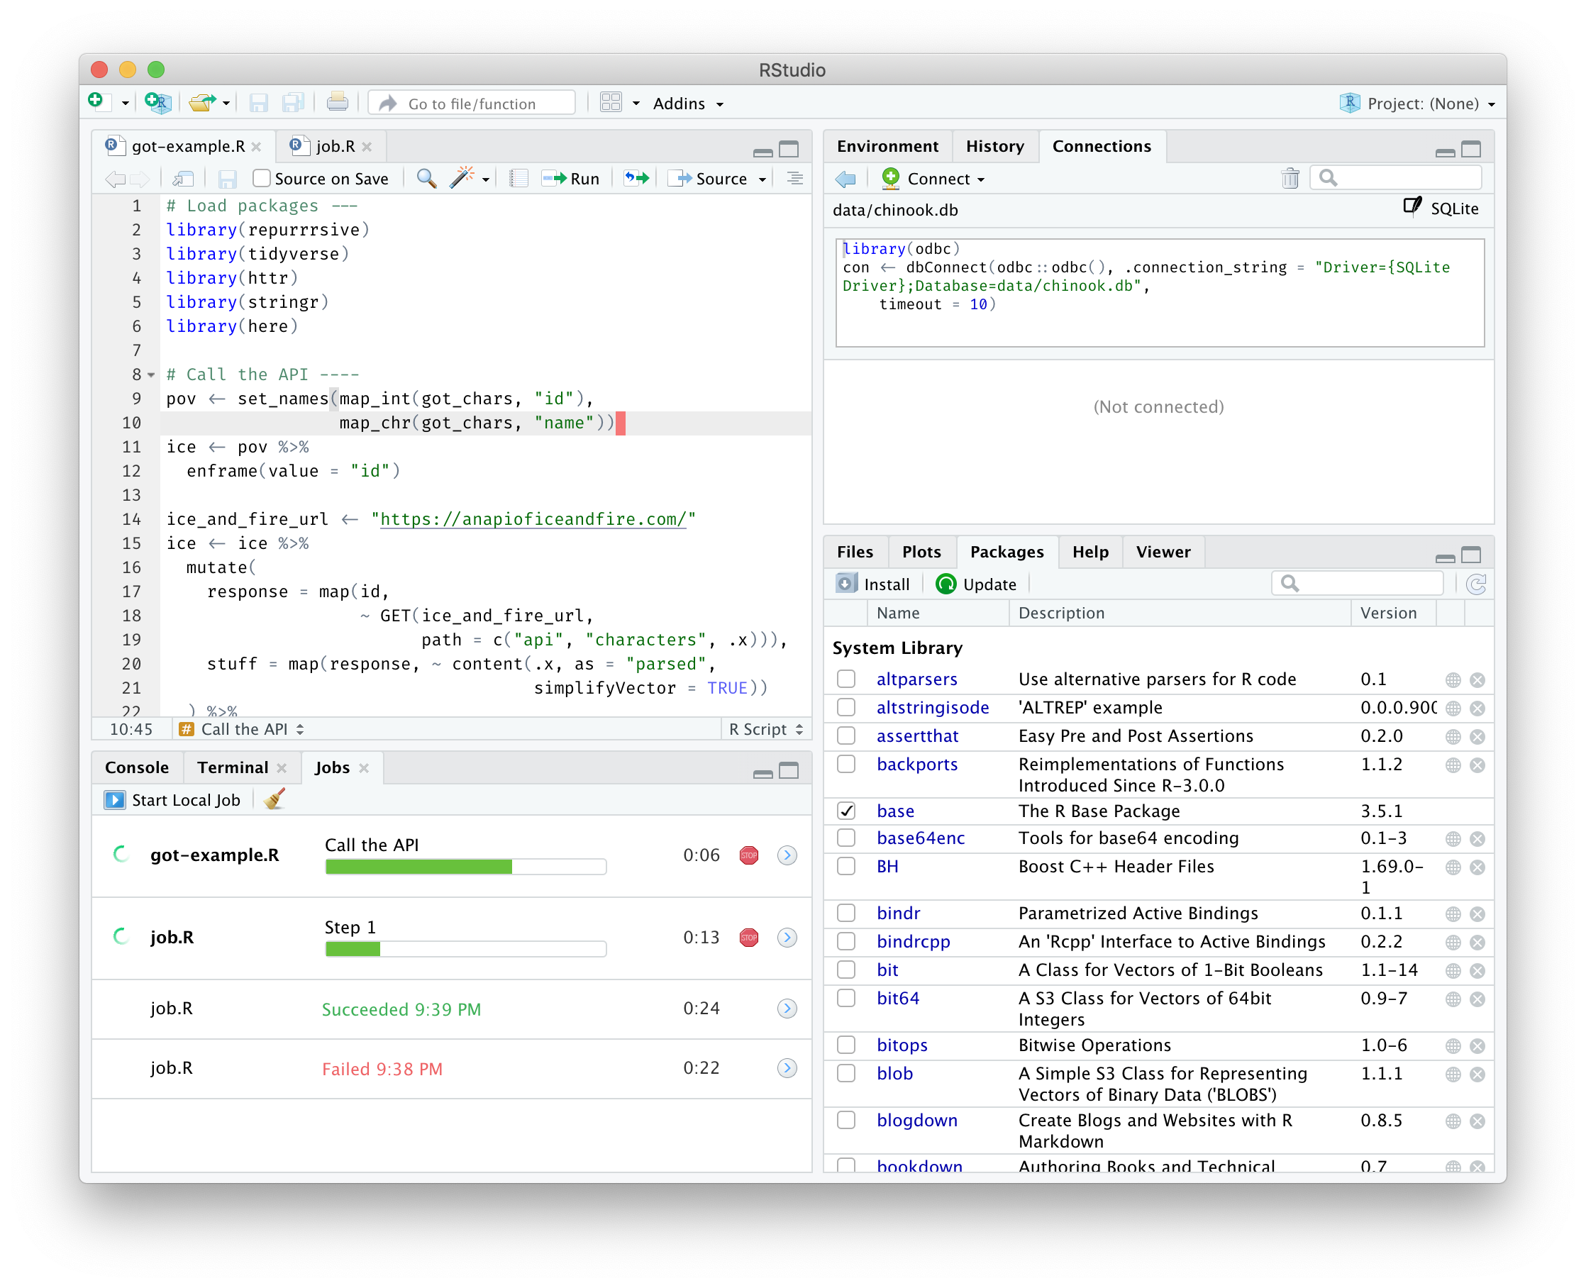
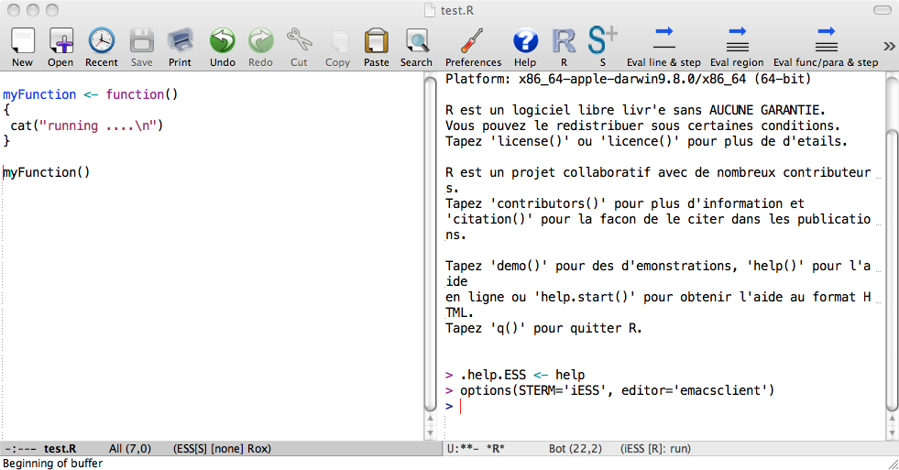
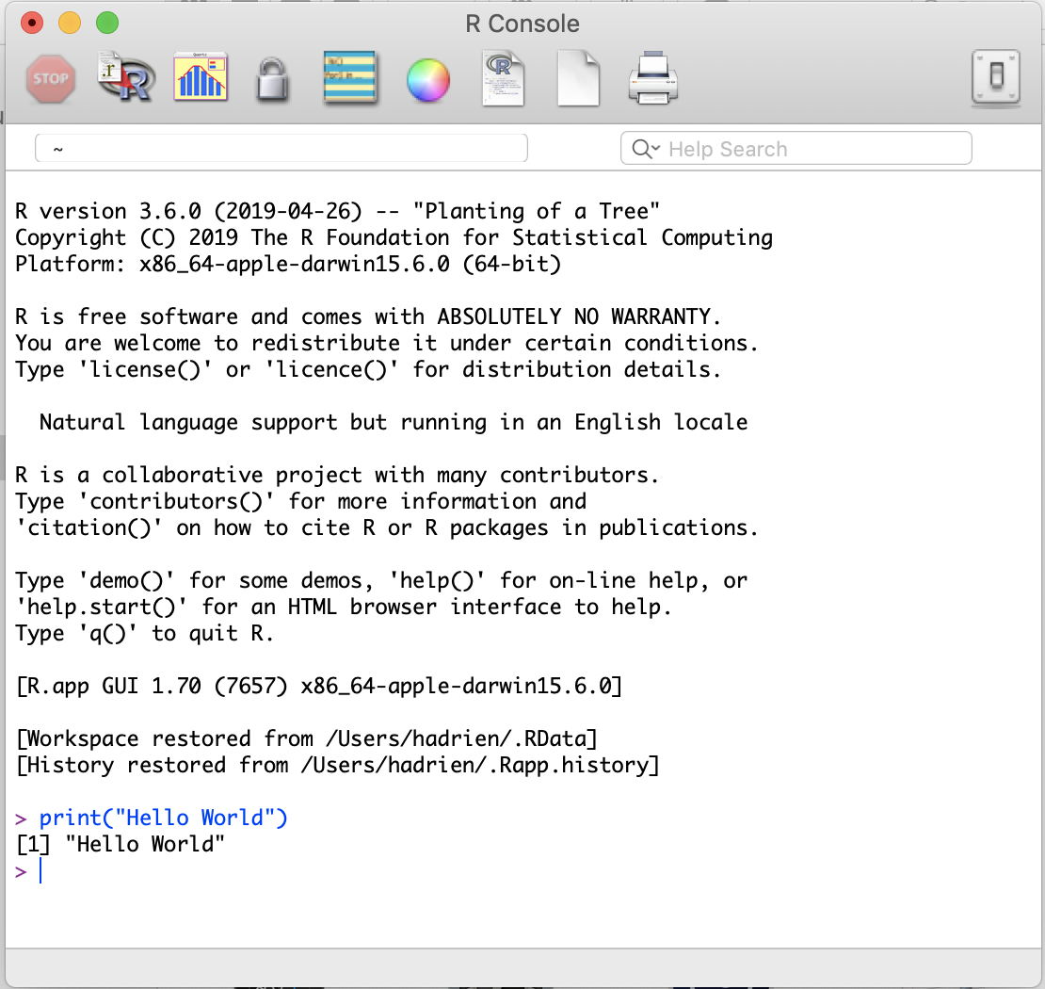
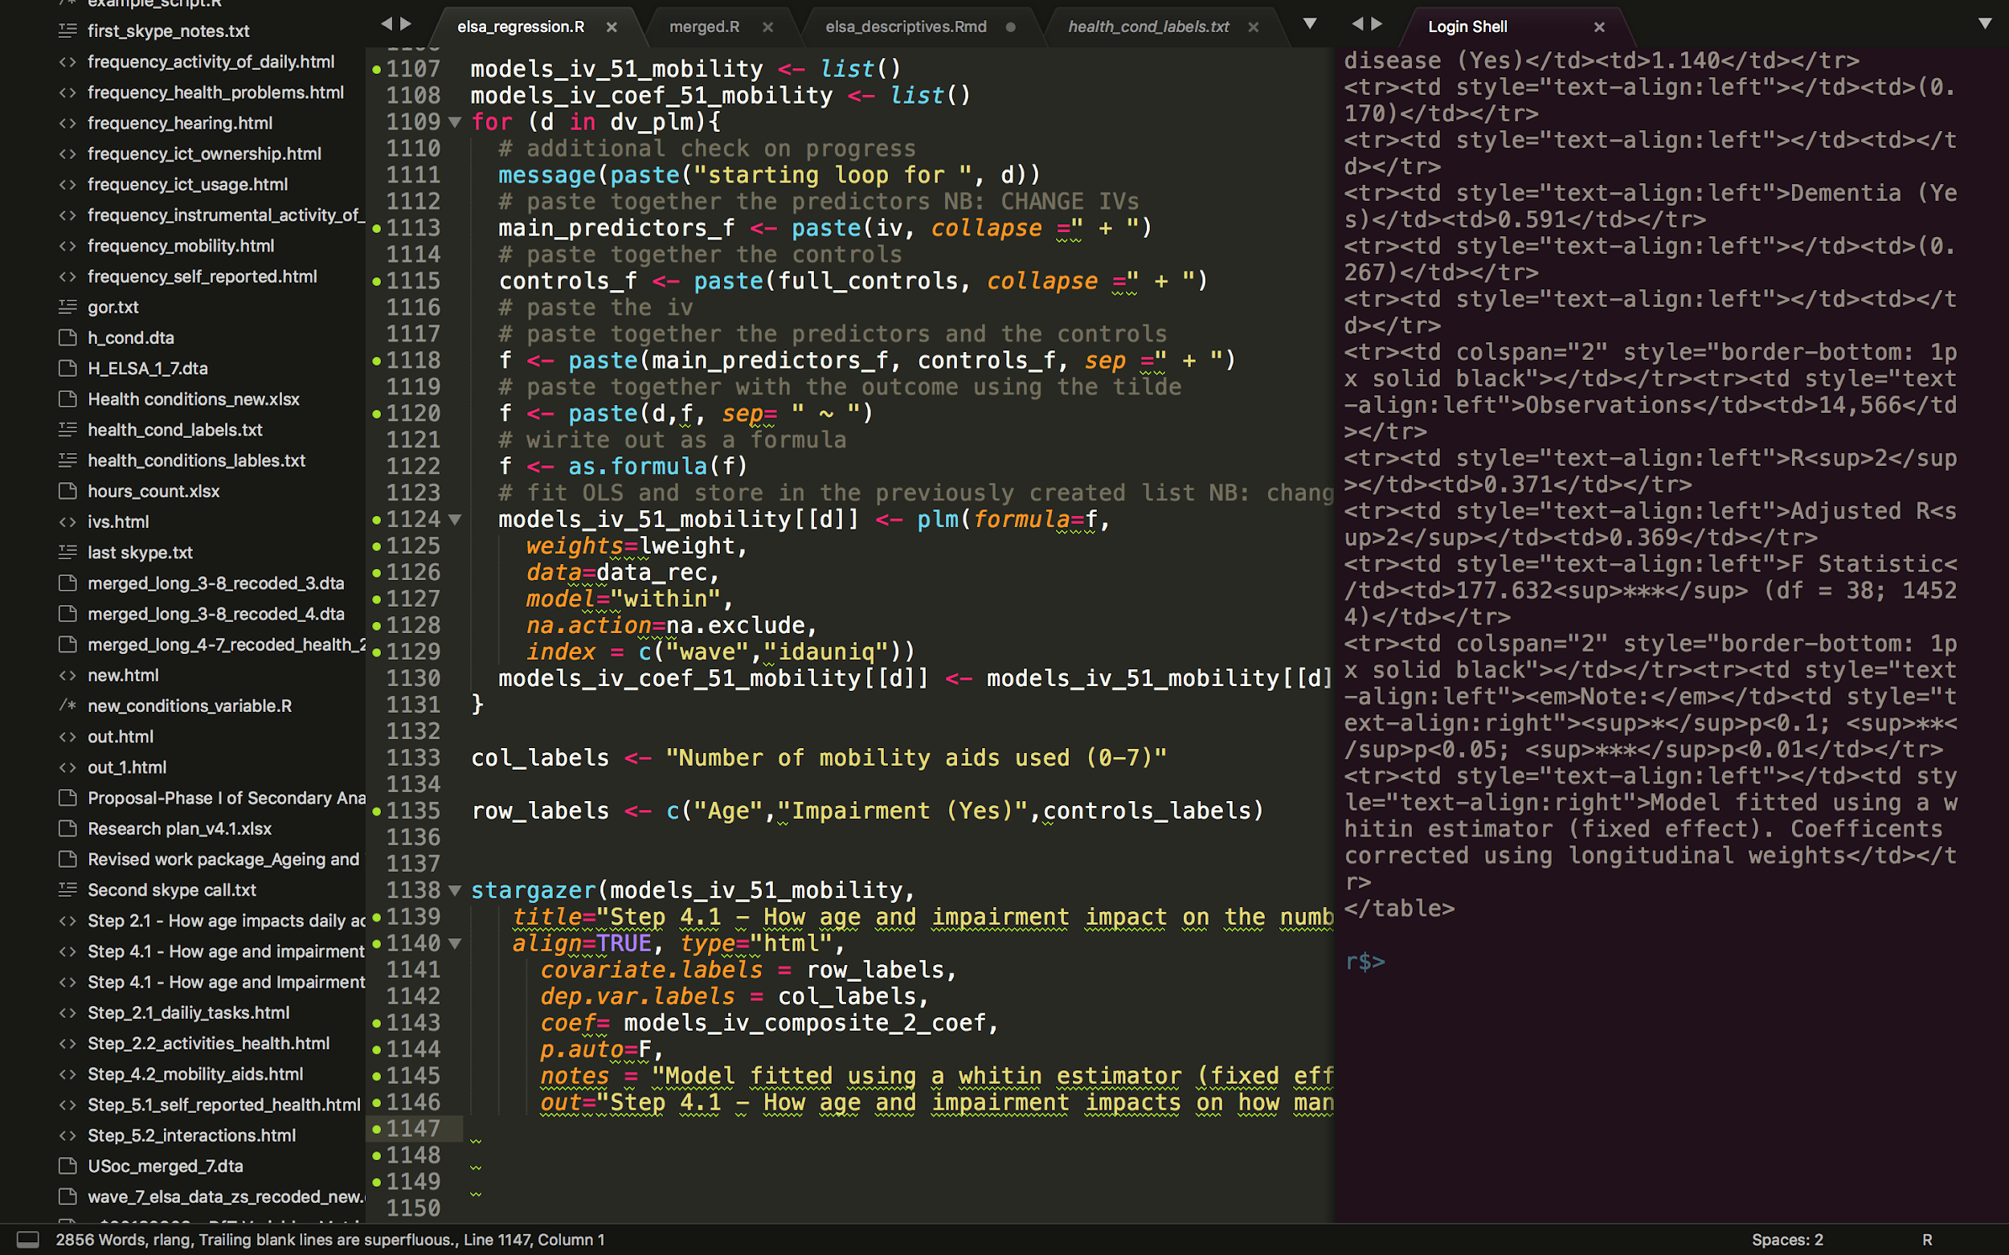
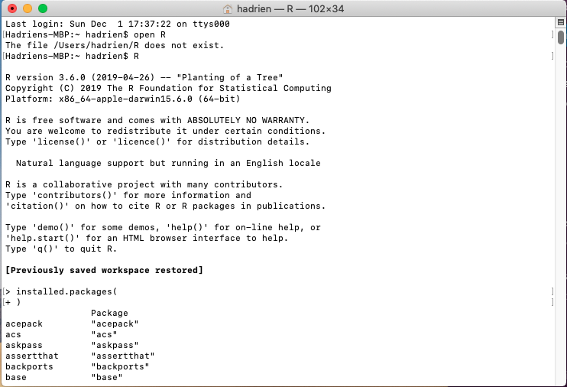
There are many ways to run R
RStudio
Emacs
R Console
Terminal
Sublime

Slide 5
How to choose which RStudio version to use
RStudio Version | Desktop or Server | Features | Pricing
RStudio Desktop | Desktop |  | Free
RStudio Desktop Pro | Desktop | Commercial License, drivers, support... | Paid
RStudio Server Open Source | Server | - | Free
RStudio Server Pro | Server | Admin tools, enhanced security + auth, adv. resource management, multiple editors, job launcher... | Paid

Slide 6
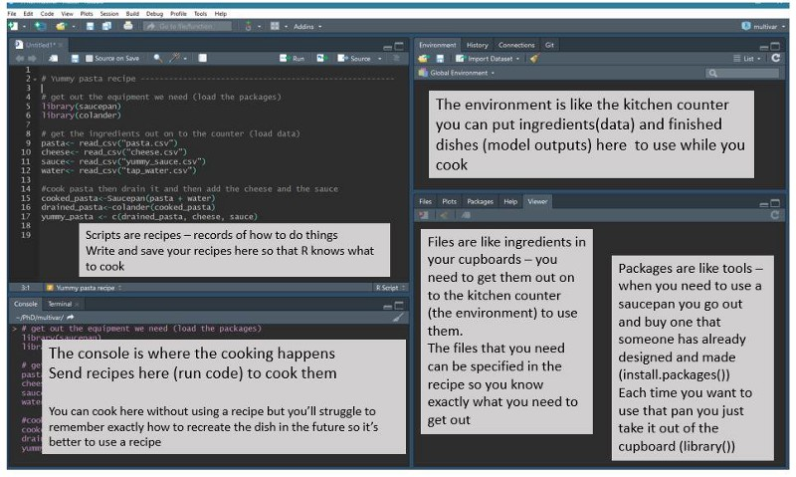
RStudio Panes

Slide 7
Links & Resources
Connections pane (article)
Using the terminal pane (article)
Version Control (webinar)
Debugging R code (webinar)
Running local & remote background jobs (webinar)
RStudio Tips Tweeter Channel
Using Python w/ RStudio (Reticulate & Jupyter)
Running RStudio Server Pro on an elastic workload manager
Email me at Hadrien@rstudio.com with questions & feedback

Slide 8
RStudio Open Source initiatives

Slide 9
IDE Open Source Initiatives
Improved multi-language R Notebooks; run Python chunks and share data with R (via reticulate)
Authoring and previewing modern web-based data visualizations (D3 widgets; via r2d3)
Better testing tools; integrated support for testing Shiny apps and R code (via shinytest and testthat)
Polyglot IDE enhancements; powerful editing modes for Python and Stan, and an integrated Python REPL
Background jobs; run R scripts asynchronously and collect results

Slide 10


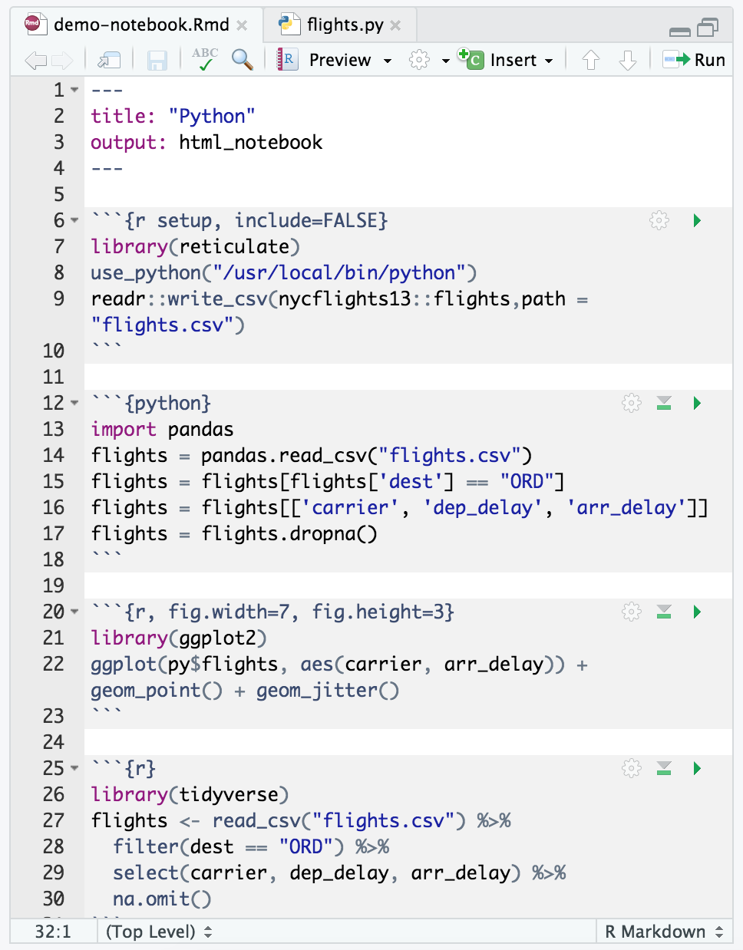
Support for multiple languages
Our philosophy is aimed at integrating Python and other languages into R projects
IDE support for Python, bash, SQL, C++, etc.
Translate, call, and bind Python from R with the reticulate package
Make Python tools (like TensorFlow and Keras) accessible to R users

Slide 11

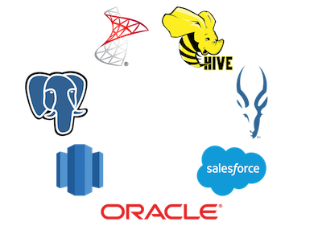
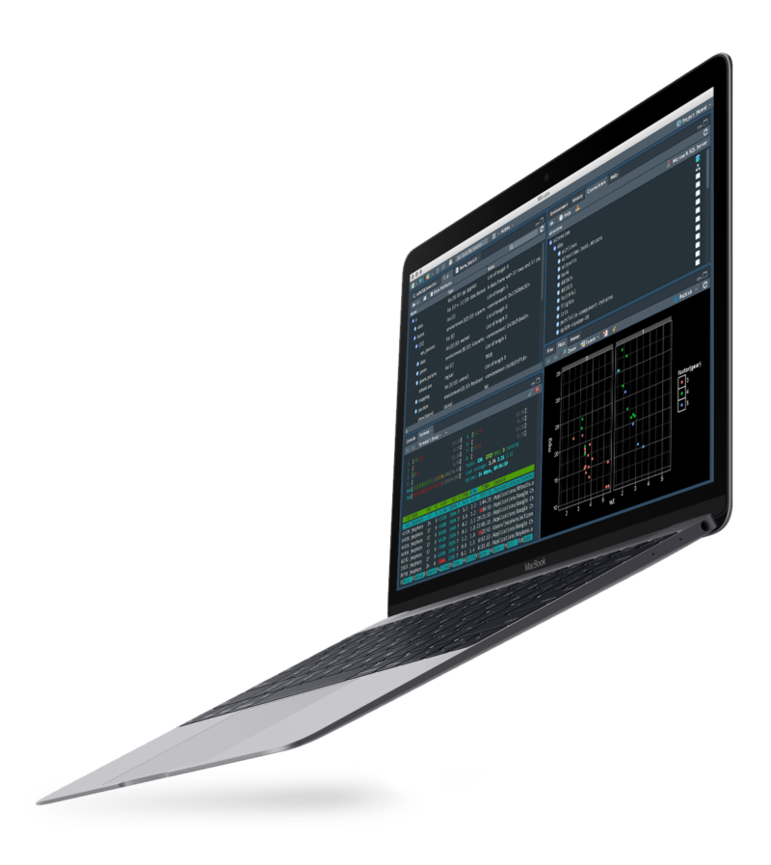
Typical Setup
External Systems
RStudio Server Pro
RStudio Connect
RStudio Desktop
RStudio Package Manager

